Slide 1

Interview guide
Religious Diversity
and Interfaith Learning
SoSe 2025
Mag.a Juidth Holzhöfer

Slide 2
Interview guide
Write the introduction
A very brief description of the research and an introduction to the researcher
Consent
Open questions
No complicated or long sentences
Well-structured
No longer than 1–2 pages
Mag.a Judith Holzhöfer

Slide 3
Interview guide
Avoid overloading the questionnaire with too many questions (10–12 questions, max. 20)
Clear and understandable questions
Value-neutral questions
Easy to use and well-organised
A deductive structure for the questionnaire: from the general to the specific
Respect the natural flow of memory and reasoning
Place questions that encourage longer narratives towards the beginning – shorter ones at the end
An open-ended guide does not block new aspects of the topic, but incorporates them
Mag.a Judith Holzhöfer

Slide 4
Interview structure
Thanks
Introduction to the researcher
Outline of the study’s objectives and general structure
Confidentiality agreement / Consent to be recorded
Interview guidelines: THERE ARE NO RIGHT OR WRONG ANSWERS
Warm-up
Long questions
Short questions (demographic data)
Thanks! And an explanation of what happens to the data
Mag.a Judith Holzhöfer

Slide 5
Types of questions
Open-ended questions Aim: to encourage the interviewee to talk
Closed questions Aim: to elicit specific information
Multi-part questions /
follow-up questions Aim: To highlight connections, encourage reflection
Situational questions Aim: to encourage reflection and specificity
Mag.a Judith Holzhöfer

Slide 6
Openness
  The respondent should be encouraged to express everything they consider important
  The researcher should listen to what is said with as few preconceptions as possible
  What is said should not be distorted by the researcher’s attitudes, beliefs and opinions
  Positive: Show genuine interest
  Show unconditional respect for the other person
  Undertake an unbiased understanding
  Negative: Make judgements, signal agreement or disagreement
  Incorporate (implicit) expectations into the questions
Mag.a Judith Holzhöfer

Slide 7
The fundamental principle of openness
  The interviewee never lies
  There are no unexpected statements
  Nothing is irrelevant
  No hypotheses, only questions
  Enable new or revised questions
Mag.a Judith Holzhöfer

Slide 8
The interview – the conversation
A relaxed atmosphere; the opening is key (small talk)
Steering the conversation
Striking a balance between letting the conversation flow and stepping in
Showing interest in new points
Save sensitive questions for the end
Don’t run over time
Off the record means off the record!!!
Mag.a Judith Holzhöfer

Slide 9
Important points to bear in mind
when conducting interviews:
Choose a suitable setting (undisturbed, natural surroundings)
Don’t forget the warm-up, introduction and conclusion
Paraphrase (repeat what has been said)
Be patient and allow the interviewee to pause to think
Facial expressions, gestures and words should not be judgemental
No preconceptions
Follow-up questions: “How did that feel for you?” “You said: … could you explain that in more detail?”
Hypothetical questions: If that were the case, how would that feel for you?
Mag.a Judith Holzhöfer

Slide 10
Important points to bear in mind
when conducting interviews:
If the interviewee can’t think of anything or very little: People think in terms of situations (“If you think back to the last time… what was that like (for you)? If you think back to the last argument, the last stressful situation in class, etc., could you describe that situation to me?”)
Introduce a different perspective: “How do you think your best friend would describe you?” “How would pupils describe you as a teacher?”
The questions do not have to be asked in order.
The questions do not have to be phrased exactly the same way.
The aim is to create a conversational atmosphere.
If a new aspect emerges – explore it.
Mag.a Judith Holzhöfer

Slide 11
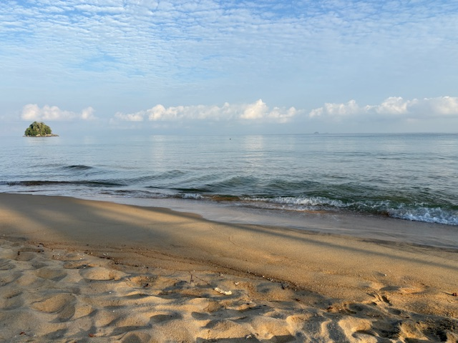
Thank you and
good luck!
Stay curious &
serious!
Mag.a Judith Holzhöfer

