Slide 1
Environmental Learning and Water Ethics in Christian-Islamic Perspective Religious Cooperating Learning
Practice Day – Teaching and Learning Materials

Slide 2
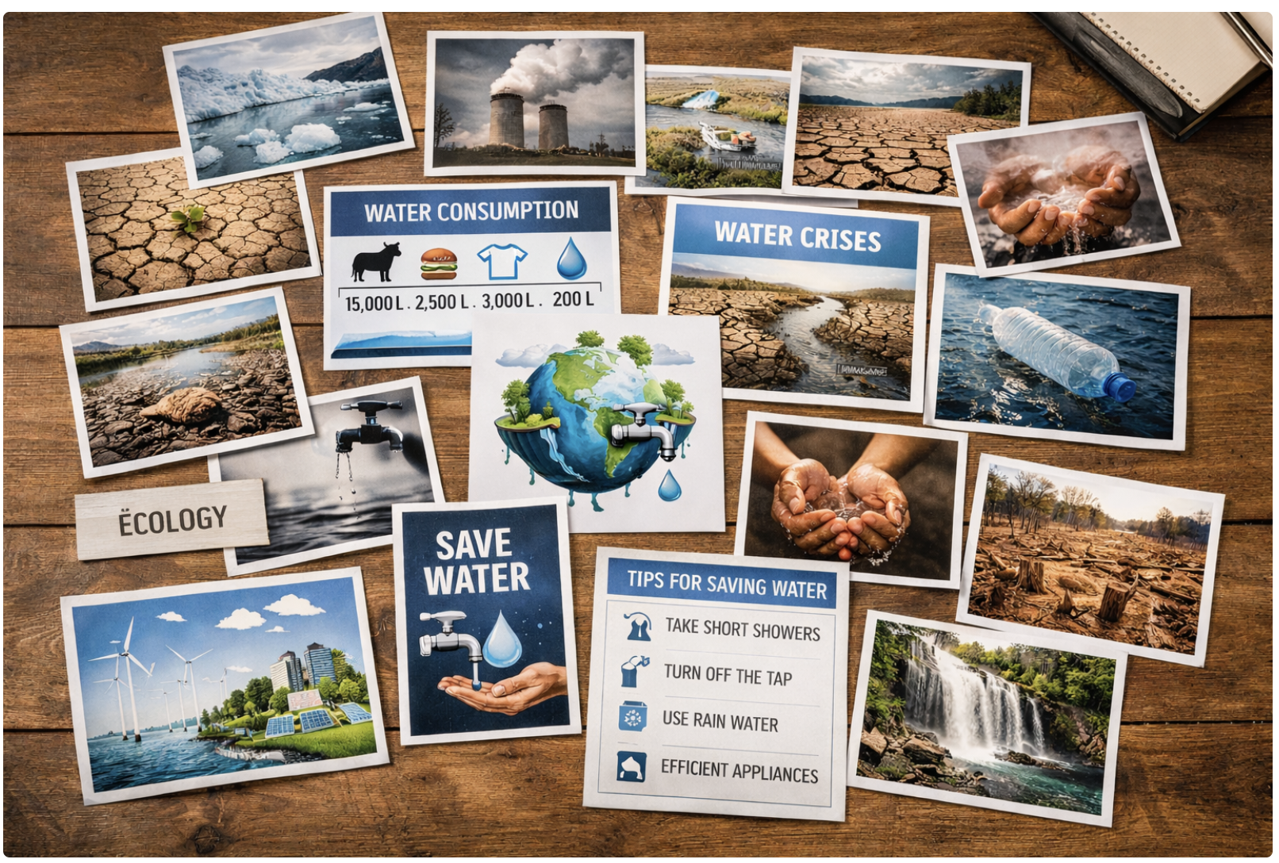
Practice Day – Teaching and Learning Materials

Slide 3
Arrival and Introduction
Glasses of water (on each per pupil) -> used as sensory introduction
Seating circle -> supports open discussion and participatory atmosphere
Images related to water (e.g. baptism, rivers, desert, pollution, sea, everyday use) ->pupils observe images and reflect on emotions and personal associations (pupils select one image and explain its personal relevance)
Digital reflection
https://www.mentimeter.com/ (digital word cloud) ->pupils submit short personal associations via smartphone
Digital display (projector or shared screen) ->results are collected and reflected on in the plenary

Slide 4
Introduction to the learning stations
Station 1: Water in the Bible and the Qur’ān
Selected Bible passages on water -> pupils read and interpret texts related to creation, life, and responsibility
Selected Qur’anic verses on water ->pupils explore Islamic perspectives on water and stewardship
Verse strips (printed on coloured paper) ->pupils assign verses to “Bible” or “Qur’ān”
Comparison worksheet -> similarities and differences are identified and documented
Instruction card ->guides text work and interreligious discussion in the group

Slide 5
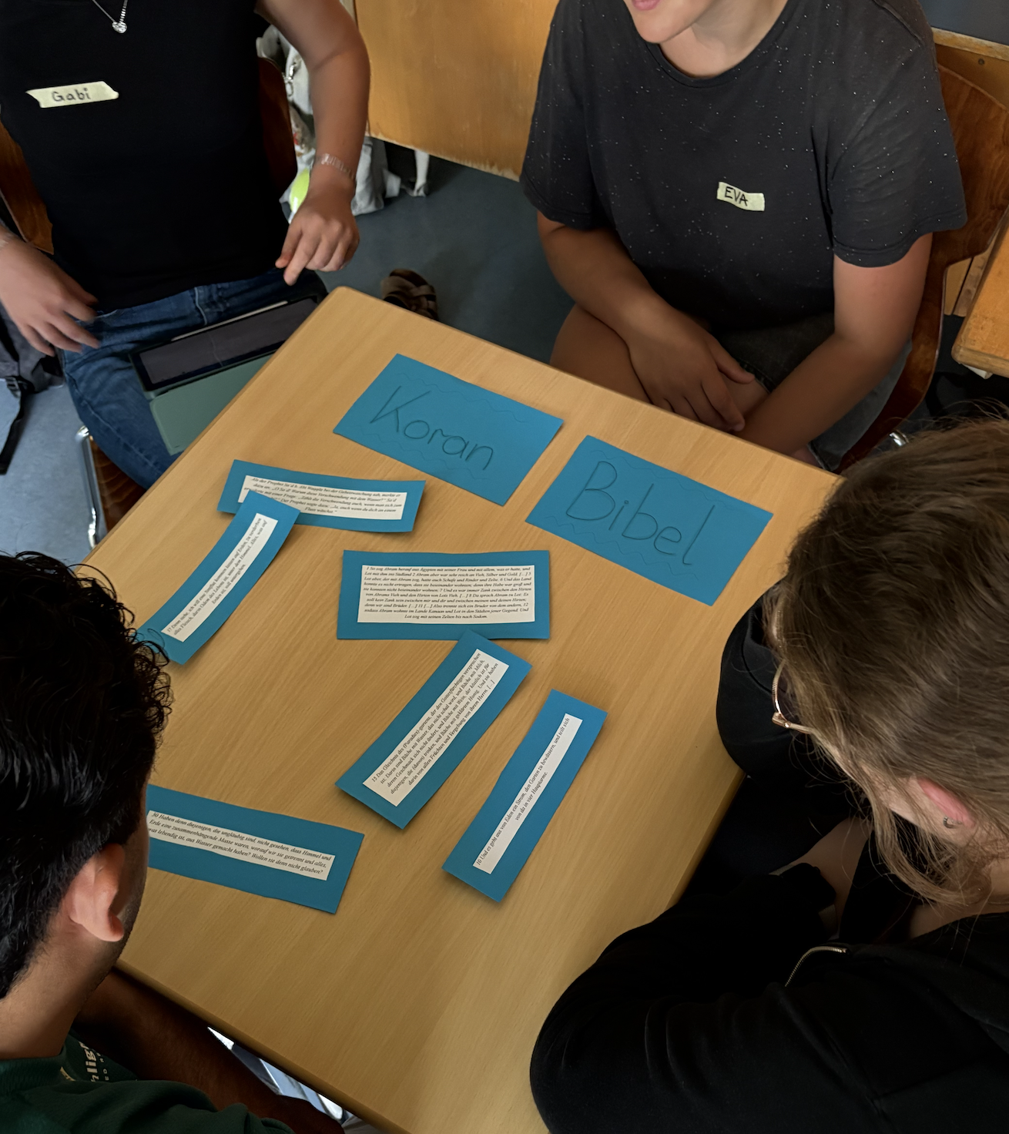
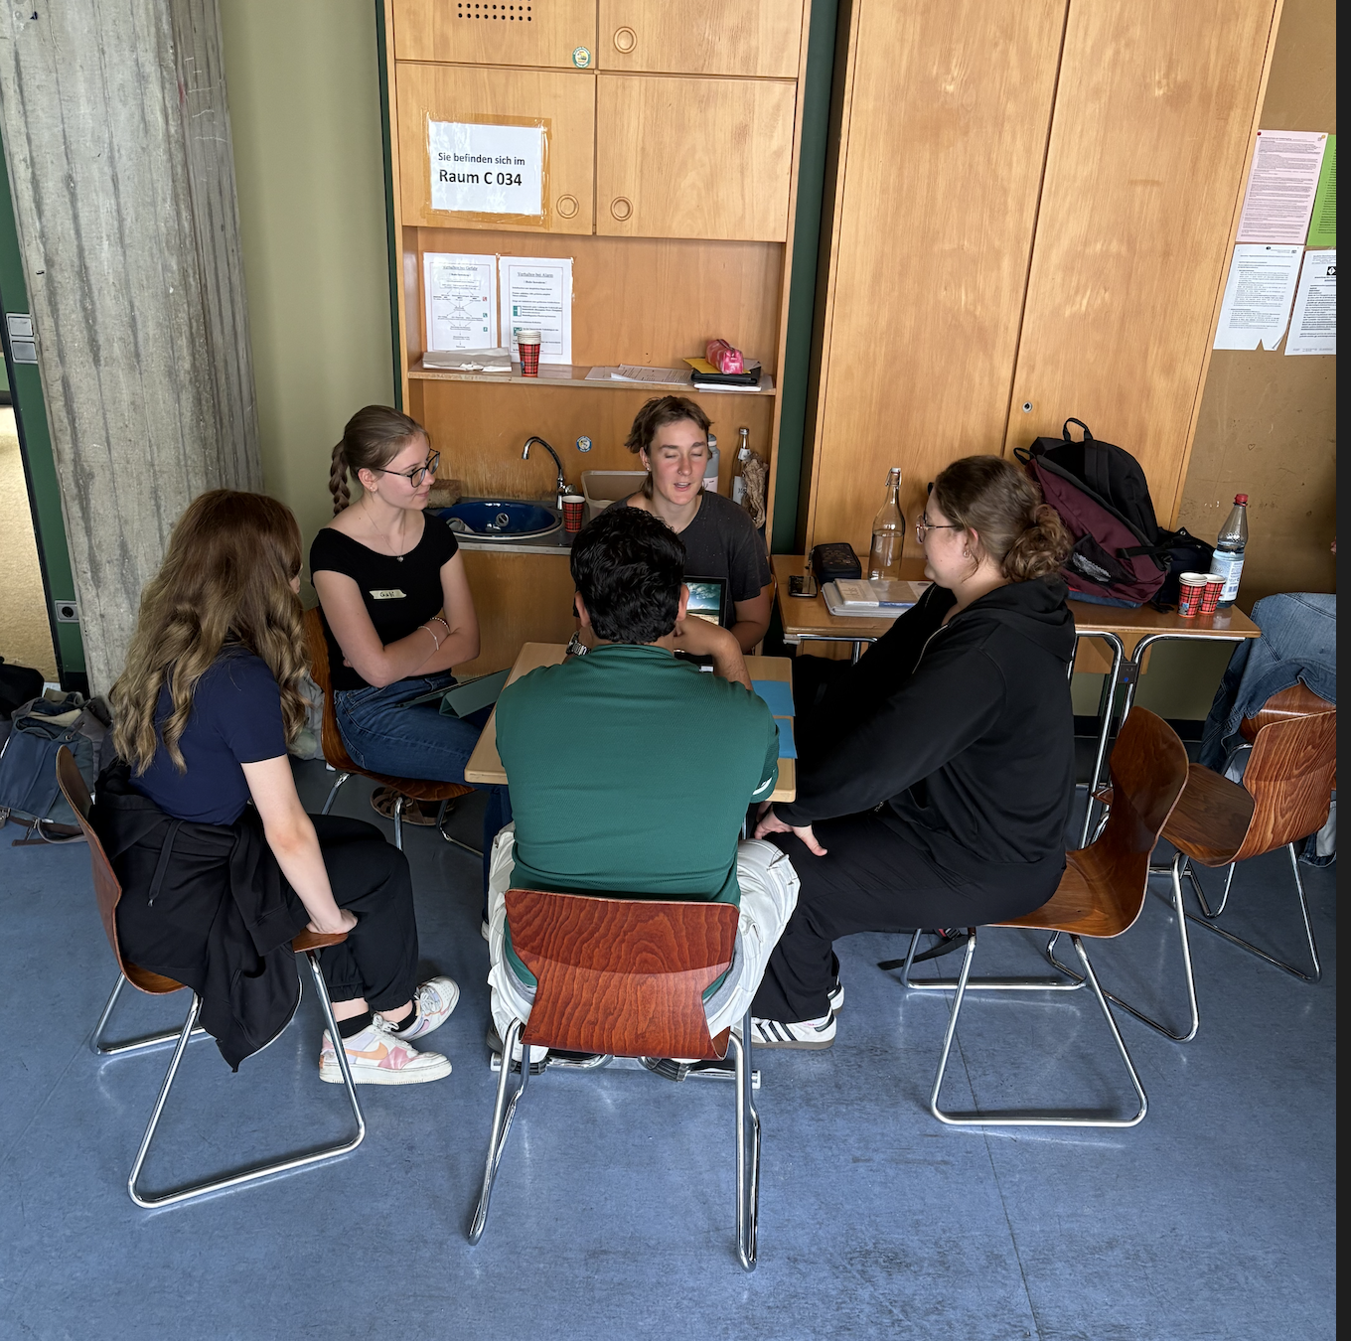

Slide 6
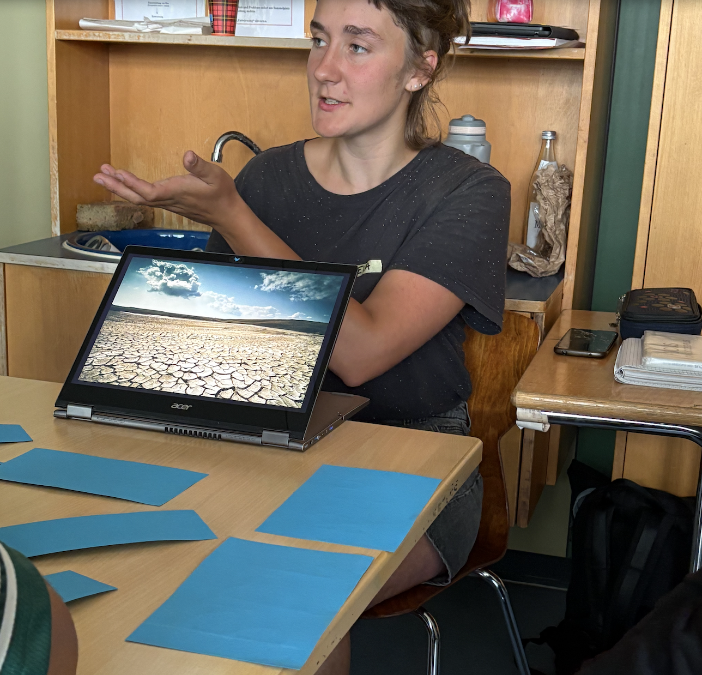
Religious dimension
Water is a gift of GOD and how can we distribute it fairly among everyone?
What is justice in my religion?

Slide 7
Station 2:
Mini Biotope – Symbol of the Water Cycle
  Glass container ->represents a closed system symbolizing the Earth’s water cycle
  Sand, gravel, soil ->layered to model natural soil structures and filtration
  Plants (e.g. lettuce or evergreen plants) -> illustrate vegetation within the water cycle
  Water and watering vessel ->used to start the water circulation process
  Instruction card ->explains step-by-step construction and observation tasks
  Image of the water cycle ->supports conceptual understanding and reflection

Slide 8
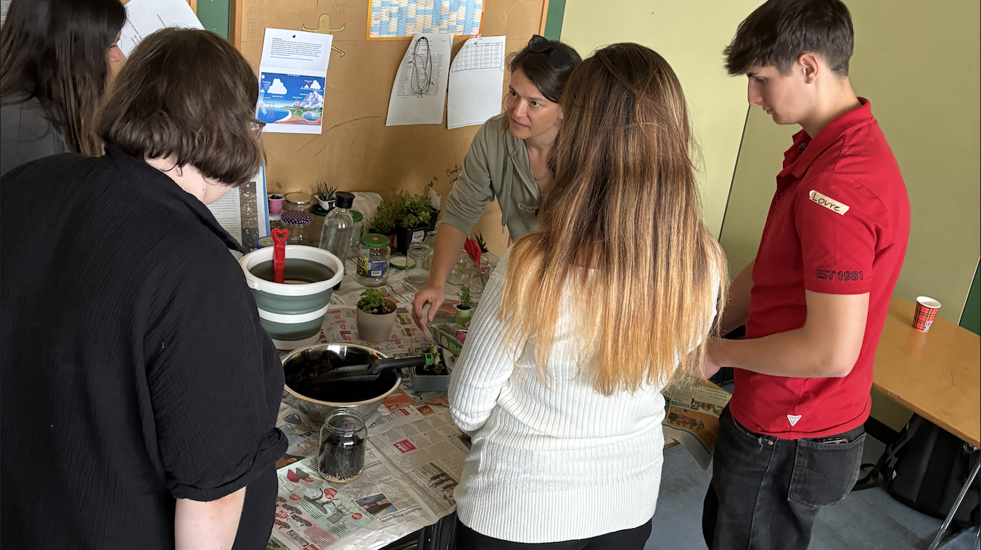

Slide 9
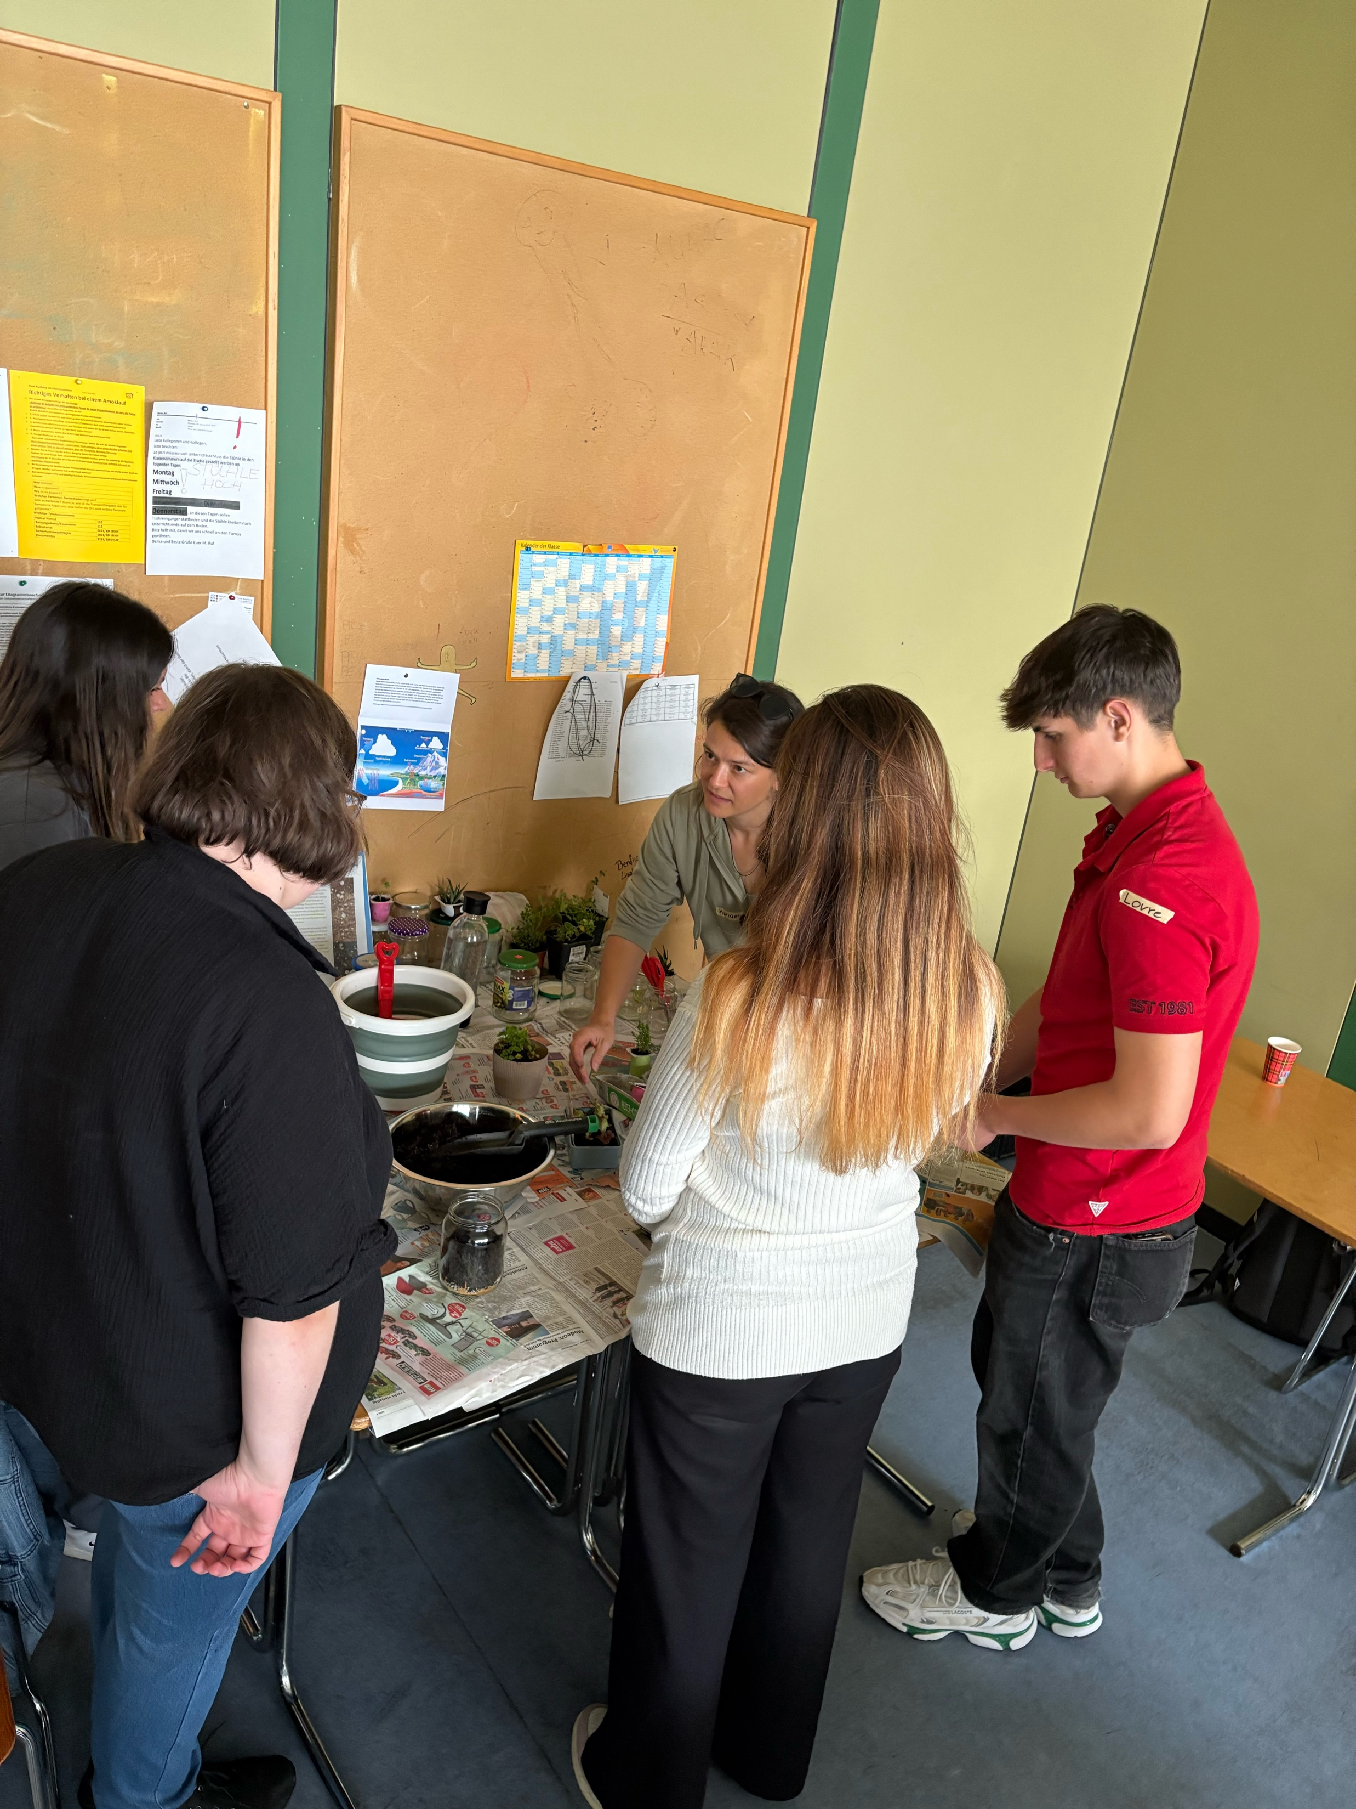
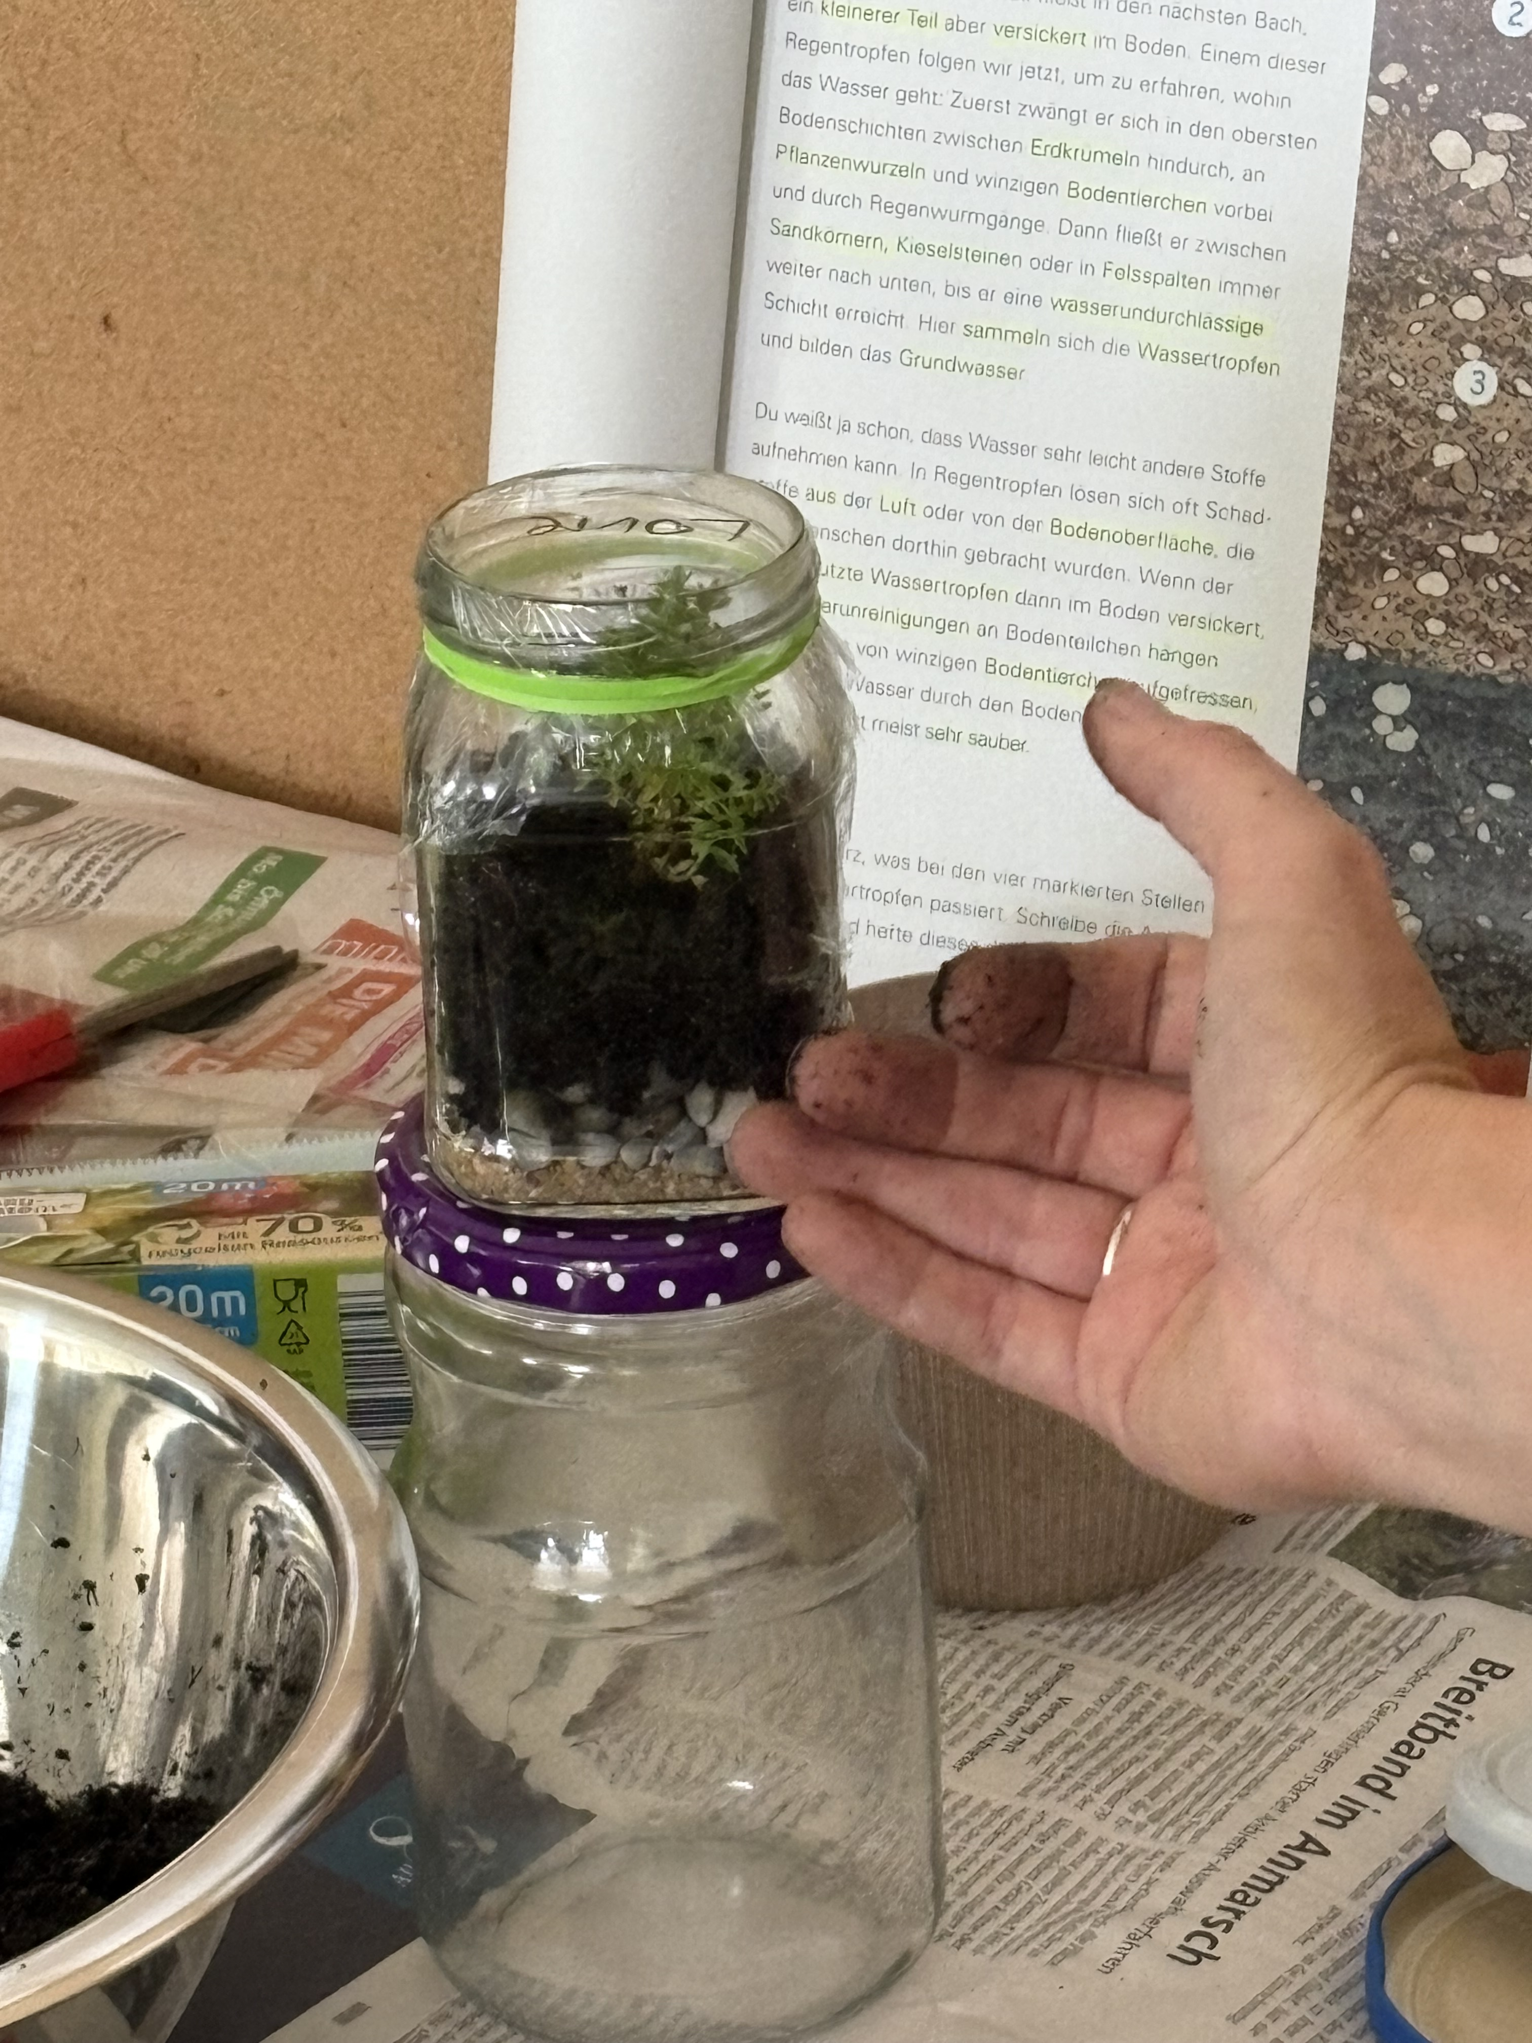
Crafting a mini greenhouse on the topic of “maintaining water balance” in miniature and in real life

Slide 10
Station 3: Saving Water in Everyday Life
Digital resource on water saving (e.g. https://ctc.ee/quizzes ) ->pupils explore concrete strategies for reducing water use
Reflection questions ->pupils discuss personal habits and possible behavioural changes

Slide 11
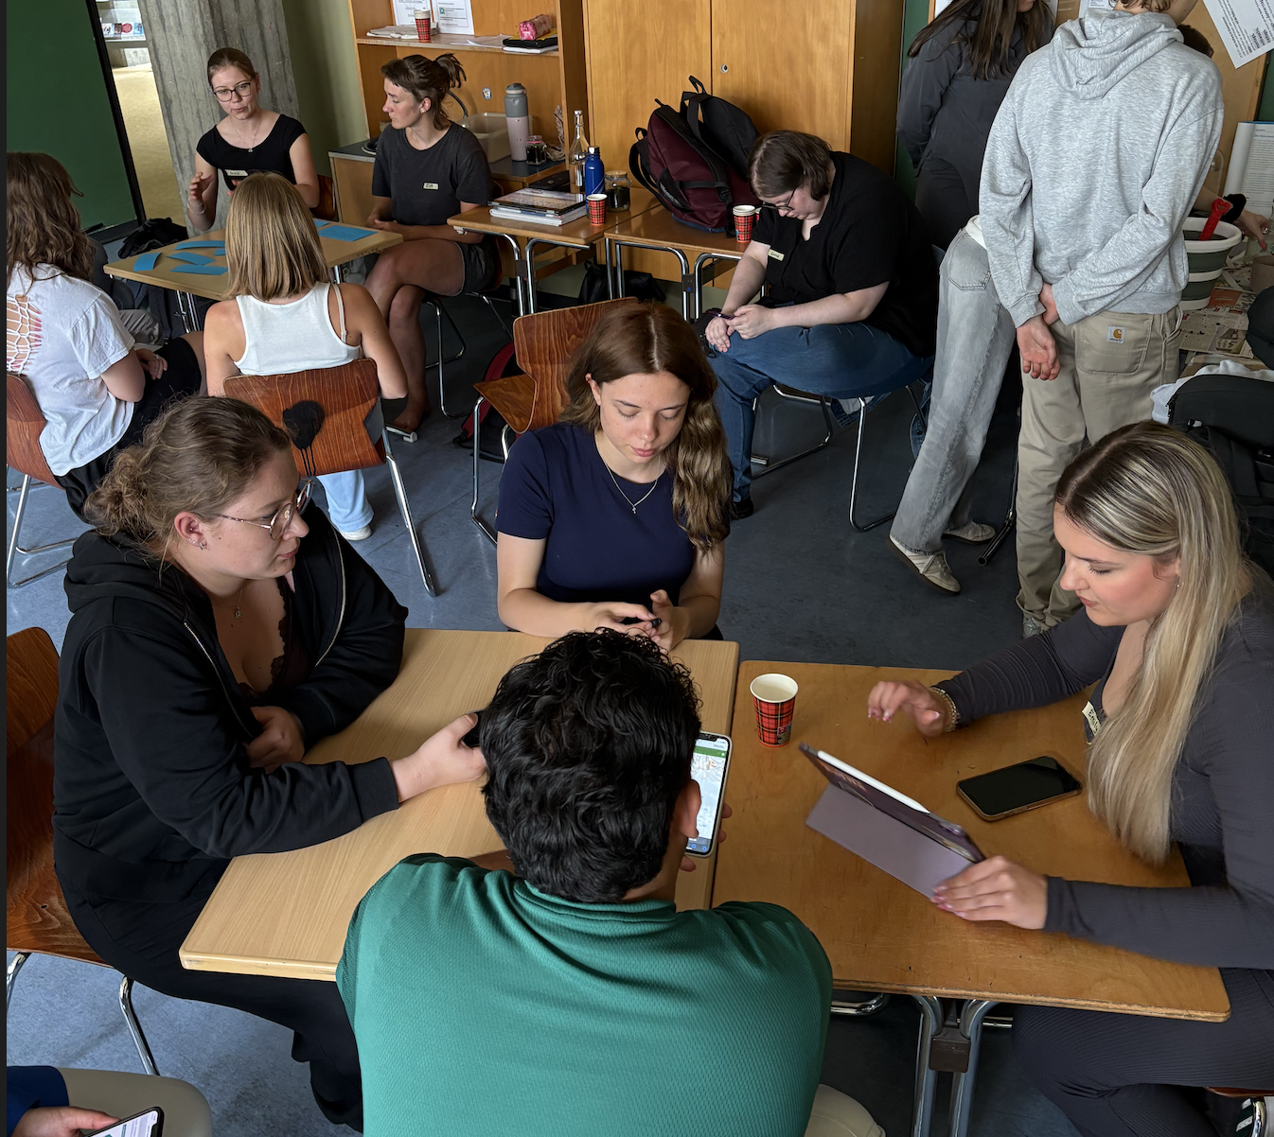
Looking for a
Win-win-situation:
How can I find a way to act responsibly while reducing my household expenses?

Slide 12
Station 4:
Hidden Water Consumption and Artificial Intelligence
Quiz with estimation questions (https://kahoot.it/ ) ->pupils estimate water use related to AI and digital technologies
Information cards on AI infrastructure (data centres, cooling systems, energy use) -> support factual understanding
Internet access (Google and alternative search engines) ->pupils research and compare information

Slide 13
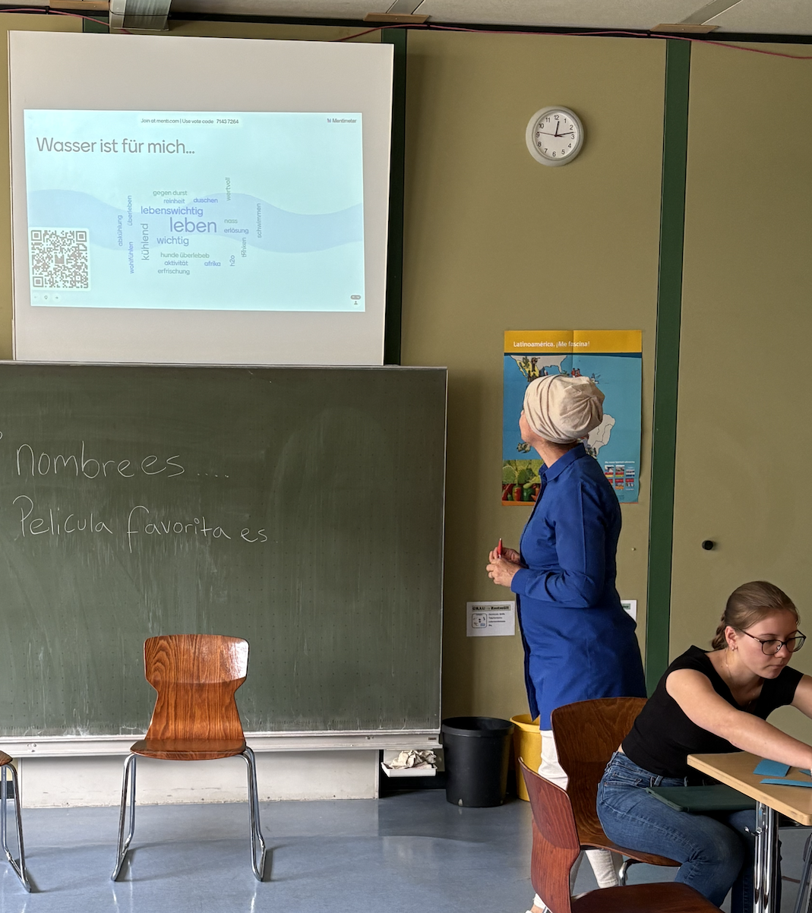

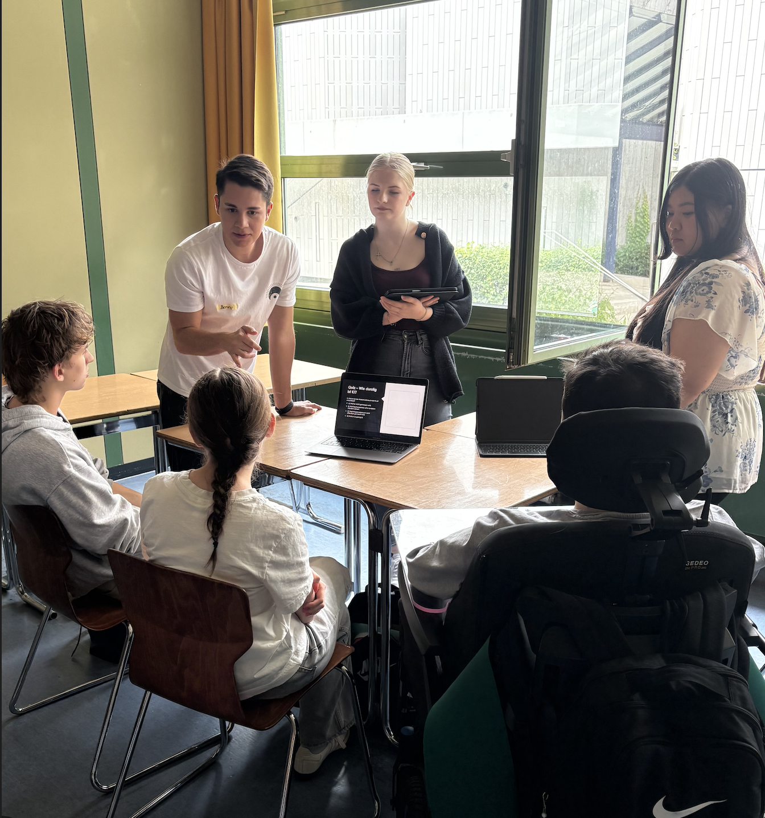

Slide 14
Our students
10 persons (5 are studying for CIM = Certificate of Interreligious Mediation; 5 are studying for Protestant Theology)
Diverse Background:
Christian (protestant, catholic and orthodox) but two of them are grown up in a mixed Christian-Islamic familiy, one of the students is from China, one of the students from Kosovo with high experiences in interfaith problems

Slide 15
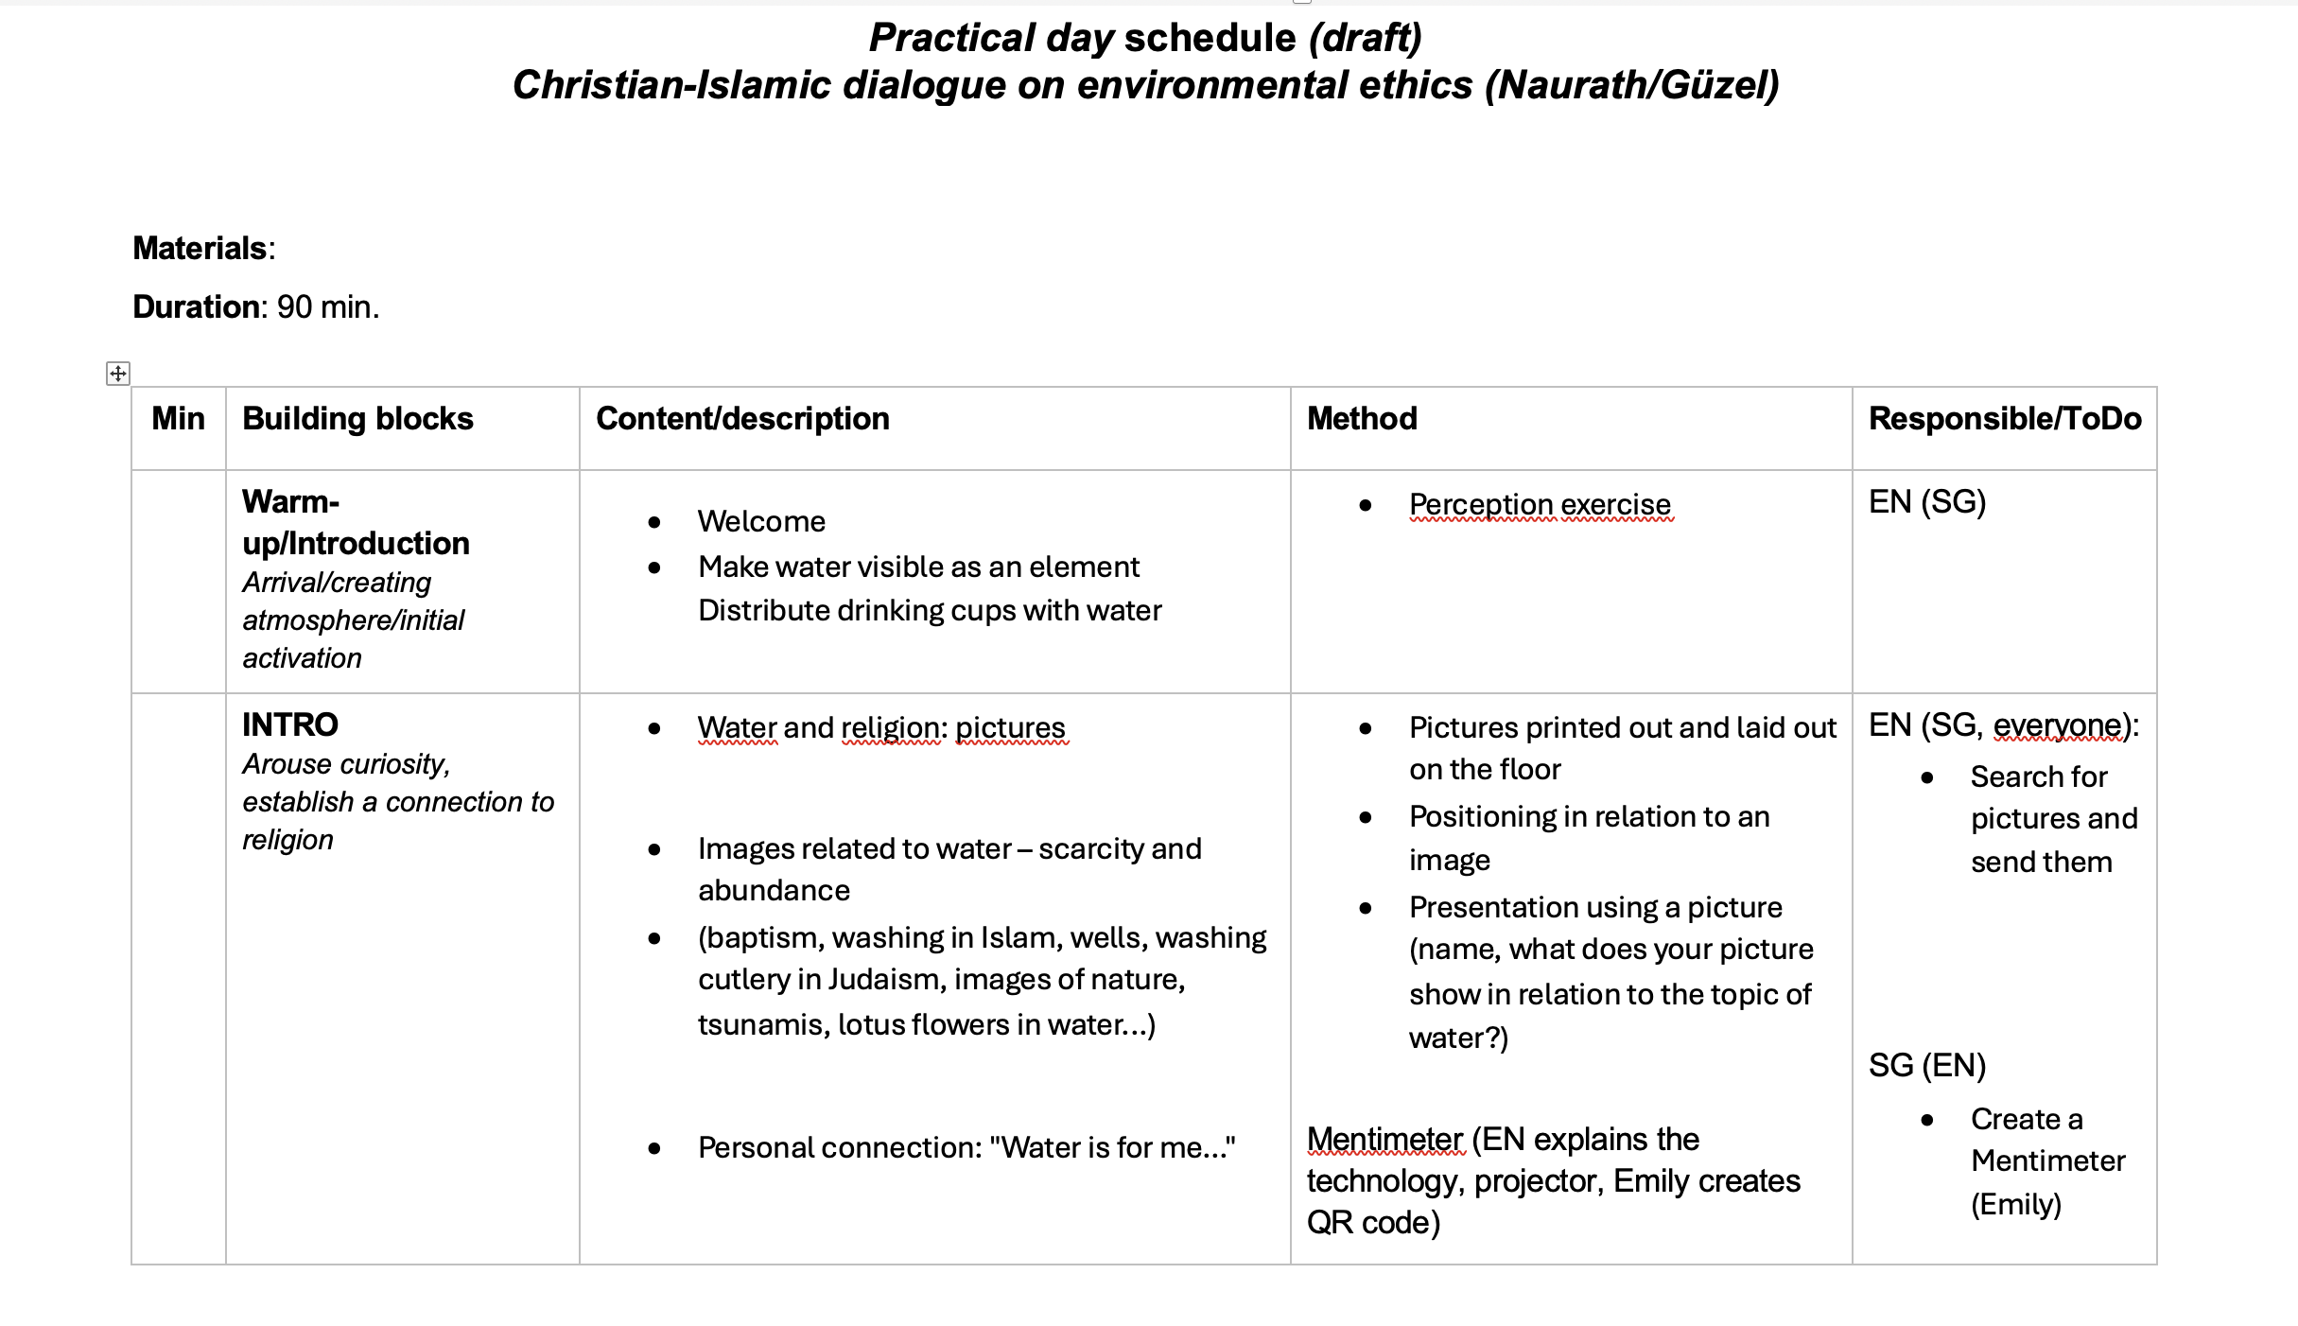

Slide 16
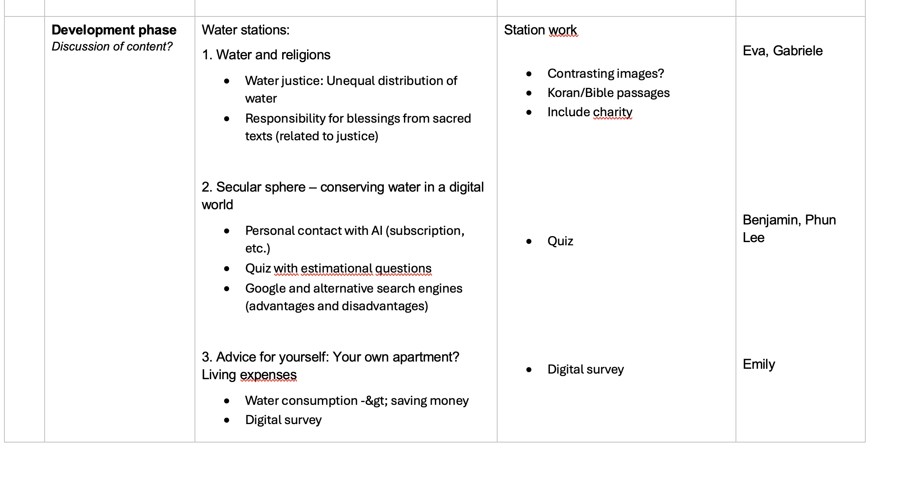

Slide 17
