Slide 1
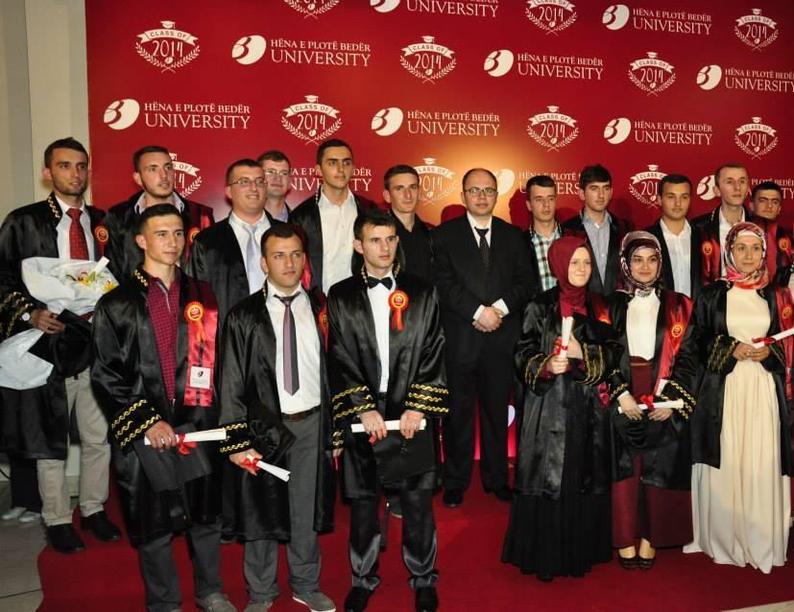
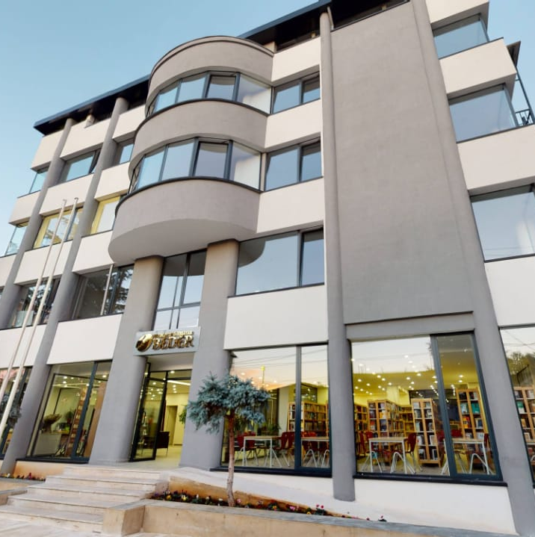

BEDER UNIVERSITY
Bachelor in Islamic Sciences
Master in Religious Studies
Master in Basic Islamic Sciences
Interfaith Dialogue
Religious Leadership
Religious Education

Slide 2
Modul: Water Ethics and Interreligious Environmental Responsibility
Islamic Perspective in the Albanian Context
Beder University College
Islamic Sciences Department
Master on Religious Studies
Course: Seminars

Slide 3
Module Overview
Water Ethics: Religion, Society & Sustainability
Water ethics as a religious, ethical, social & sustainability issue
Grounded in Islamic Environmental Ethics
Enriched through interreligious dialogue
Water as sacred element and public good
Integrates theology, ethics, sustainability & applied case studies
Notes:
Module Overview
This four-week university module explores water ethics as a religious, ethical, social, and sustainability issue, grounded primarily in Islamic environmental ethics and enriched through interreligious dialogue, with a strong focus on the Albanian context.
The course explores water ethics as a critical environmental, social, and moral challenge through the lenses of Islamic environmental ethics and interreligious dialogue. Water is examined as both a sacred element and a public good, integrating theological reflection, ethical theory, sustainability frameworks, and applied case studies.
Drawing on Islamic eco-theological principles—Amanah (trust), Khalifah (stewardship), Mizan (balance), Maslahah (public good), Tawhid (divine unity), and Akhirah (accountability)—the course connects religious ethics with contemporary issues of *water justice, governance, climate change, and sustainable development.
The module aligns with the framework of Interreligious Education for Sustainable Development (irBNE) and the UN Sustainable Development Goals, particularly SDG 6 (Clean Water and Sanitation), while also addressing SDG 12 (Responsible Consumption) and SDG 13 (Climate Action).
The Albanian context serves as a living case study, while comparative interreligious perspectives broaden the European and global relevance of the course. The syllabus is aligned with Erasmus+ priorities, the European Green Deal, and Education for Sustainable Development (ESD).

Slide 4
Module Information
4-week university module
Partner Organizations: Interreligious Council of Albania; Religions for Peace, KAICCID
Target Group: Master students
Prerequisites: Basic knowledge of religion, ethics, or sustainability concepts

Slide 5
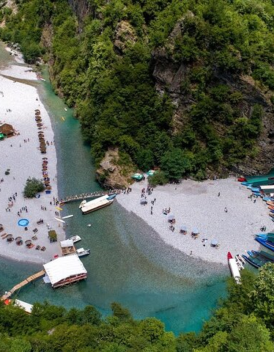
Contextual Framework: Albania
Water-rich country facing ethical, environmental & governance challenges
Key issues:
Unequal access to drinking water
River pollution (Lana, Ishëm, Erzen, Seman)
Inefficient infrastructure & water waste (israf)
Climate-related floods & droughts
Strong tradition of religious coexistence and public trust in faith communities
Water framed as amanah (divine trust) and a basis for faith-based environmental responsibility

Slide 6

Learning Objectives & Competencies
Water ethics: Islamic & environmental perspective
Albanian water challenges: analysis & solutions
Religious & interreligious approaches
Interreligious dialogue on water issues
Faith-based roles in governance
Apply ethics to water justice & sustainability
Design small educational/community initiatives
Link religious ethics to SDGs

Slide 7
Module Structure
Week 1: Water as Sacred Creation and Divine Trust (Amanah)
Water in the Qur’an and Prophetic tradition
Amanah and Khalifah as ethical responsibilities
Ritual purity (wudu) and moderation in water use
Cultural and religious perceptions of water in Albania

Slide 8
Key Questions
Why is water considered sacred in Islam?
Is wasting water a moral failure?
How do Albanian practices reflect or contradict Islamic teachings?
Activities
Textual analysis of Qur’anic verses and Hadith
Discussion on personal and community water use in Albania
Reflection on water consumption habits
Assignment
Short reflective essay (500 words): Water as Amanah in my personal and local context

Slide 9
Week 2:
Islamic Environmental Ethics and Water Justice in Albania
Core eco-Islamic principles: Khalifah, Mizan, Maslahah, Tawhid, Israf, Akhirah
Water justice, public good, and environmental responsibility
Pollution, river degradation, and water governance in Albania
Link to SDG 6, SDG 12, and SDG 13

Slide 10
Key Questions
Which Islamic ethical principles are most violated in Albania’s water management?
How does water injustice affect social cohesion and sustainability?
Activities
Case studies on Albanian rivers and water infrastructure
Group work linking Islamic ethics with sustainability goals
Critical discussion on institutional and communal responsibility
Assignment
Group presentation: Water justice in Albania through Islamic environmental ethics

Slide 11
Week 3:
Interreligious Perspectives on Water in the Albanian Reality
Water in Christianity, Judaism, and other ethical traditions
Albania as a model of interreligious coexistence
Shared moral values and differences in religious approaches to water
Interreligious cooperation for environmental protection

Slide 12
Key Questions
What ethical values regarding water are shared across religions?
How can Albanian faith communities cooperate on water issues?
Activities
Moderated interreligious dialogue or role-play
Comparative reflection on religious texts and practices
Analysis of the role of mosques, churches, and tekkes in environmental awareness
Assignment
Comparative reflection paper: Interreligious water ethics in the Albanian context

Slide 13

Week 4: From Ethics to Action – Education, Community, and Advocacy
Focus
Faith-based environmental education in Albania
Role of youth, universities, and religious institutions in sustainability
Community engagement and advocacy for water protection
Faith-based environmental initiatives (Islamic Relief, Ummah for Earth, Al-Mizan Covenant)
Education for Sustainable Development (ESD) frameworks and practice
Youth engagement, leadership, and advocacy
Project design and presentation of applied water ethics initiatives

Slide 14
Activities
Design of educational or awareness-raising materials
Drafting a small community or interreligious project proposal
Student presentations and peer feedback
Final Assessment
Applied group project + individual reflective report

Slide 15
References & Literature
Primary Islamic Sources
The Qur’an
Sahih al-Bukhari
Sahih Muslim
Ibn Kathir, Tafsir al-Qur’an al-‘Azim
Islamic Environmental Ethics
Foltz, R. C., Denny, F. M., & Baharuddin, A. (eds.). Islam and Ecology: A Bestowed Trust. Harvard University Press, 2003.
Izzi Dien, M. Islamic Environmental Ethics, Law, and Society. Routledge, 2000.
Nasr, S. H. Man and Nature: The Spiritual Crisis of Modern Man. Kazi Publications, 1997.
Kamali, M. H. The Middle Path of Moderation in Islam. Oxford University Press, 2015.

Slide 16
References & Literature
Water Ethics and Sustainability
UNESCO. Water Ethics and Water Resource Management.
United Nations. SDG 6: Clean Water and Sanitation – Global Reports.
Shiva, V. Water Wars. South End Press, 2002.
Interreligious and Faith-Based Sources
Religions for Peace. Faiths and the Sustainable Development Goals.
Pope Francis. Laudato Si’. Vatican, 2015.
Jenkins, W., Berry, E., & Kreider, L. Religion and Climate Change. Oxford University Press, 2018.
Albanian and Regional Context
UNDP Albania. Water Governance and Climate Change Reports.
Ministry of Tourism and Environment of Albania. National Strategy on Water Resources Management.
European Environment Agency (EEA). Western Balkans: Water and Environmental Challenges.

Slide 17
Conclusion
This module positions Islamic environmental ethics and interreligious dialogue as practical resources for addressing water-related challenges in Albania. It combines theology, sustainability, and civic engagement, preparing students to act as ethically informed, socially responsible, and dialogically competent citizens.

Slide 18
Thank you!
Albania Team!

